Slide 1

SOFTWARE DEVELOPMENT LIFE CYCLE
PROF. S. LAKSHMANAN,
DEPT. OF B. VOC. (SD & SA),
ST. JOSEPH'S COLLEGE.

Slide 2
AGENDA
1
SDLC
2
3-Tier Architecture
3
Coding
4
Project Execution
5

Slide 3
PRINCIPLES OF SOFTWARE ENGINEERING
Software Engineering
Software Engineers

Slide 4
Software Engineering
Software engineering is the study and application of engineering to the design, development and maintenance of project.
Software Engineers
Software engineers apply the principles of engineering to the design, development, maintenance, testing, and evaluation of the software and systems that make computers or anything containing software work.

Slide 5
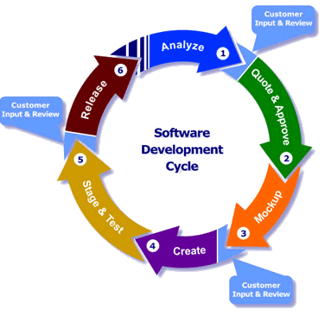
STEPS IN SOFTWARE ENGINEERING
  Software Requirements
  Analysis
  Design
  Construction
  Testing
  Maintenance

Slide 6
  SOFTWARE REQUIREMENTS
  Client requirements say what the software should do.
  ANALYSIS
  Involves carrying out detailed study of the customer requirements and arriving at the exact requirements of the proposed system.
  DESIGN
  Involves translating the identified requirements into a logical structure that can be implemented in the programming logic.
    Flowchart: Proposed system full project flow
    Mock-ups: Screens involved and its structural design

Slide 7
CONSTRUCTION
After the design phase is done, each component (part) of the software is coded.
Code is what tells the computer exactly what to do at each step.
TEXT EDITOR
Usually part of an IDE - Integrated Development Environment
TESTING
Testing is done to see if the components meet the requirements and that the system as a whole meet the goal, by a finite set of test cases against the domain behaviour.
MAINTENANCE
Part or all of this process can repeat if bugs are found or new requirements are needed.

Slide 8
WATERFALL MODEL
In a waterfall model, each phase must be completed fully before the next phase can begin.
In waterfall model phases do not overlap.

Slide 9
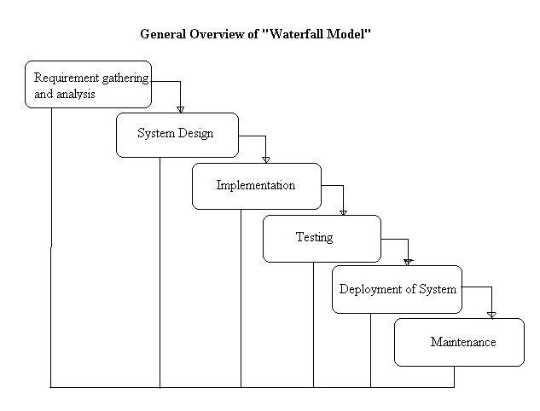

Slide 10
When To Use The Waterfall Model
This model is used only when the requirements are very well known, clear and fixed.
Product definition is stable.
Technology is understood.
There are no ambiguous requirements
Ample resources with required expertise are available freely
The project is short.

Slide 11
AGILE MODEL
In Small Incremental releases with each release building on previous functionality.
Each release is thoroughly tested to ensure software quality is maintained.
It is used for time critical applications.

Slide 12
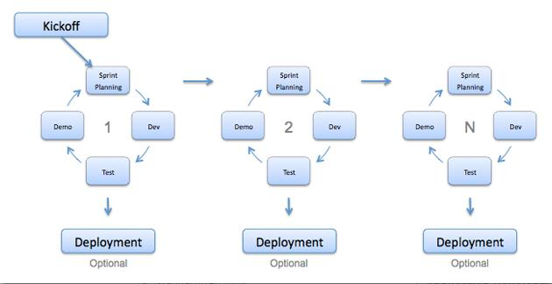

Slide 13
WHEN TO USE AGILE MODEL
When new changes are needed to be implemented.
The freedom agile gives to change is very important.
New changes can be implemented at very little cost because of the frequency of new increments that are produced.
To implement a new feature the developers need to lose only the work of a few days, or even only hours, to roll back and implement it.

Slide 14
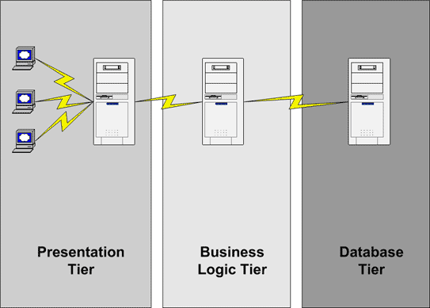
3- TIER ARCHITECTURE

Slide 15
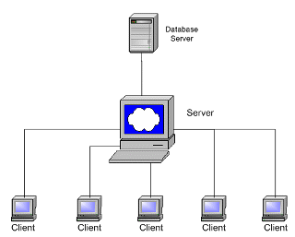
What is 3-Tier Architecture
A three-way interaction in a client/Server environment
  The User Interface is stored in the Client.
  The Business Application Logic is Stored in one or more Servers.
  The Data is Stored in a Database Server.

Slide 16
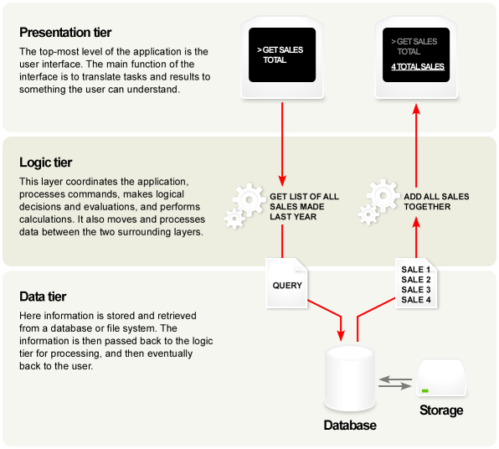

Slide 17
EVOLUTION TO THE 3-TIER ARCHITECTURE
Single Tier
Dual Tier
3-Tier
…
N-tier
Tiers we are going to study

Slide 18
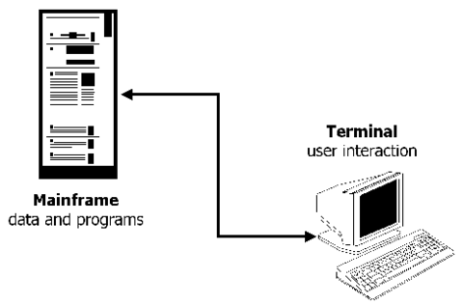
SINGLE TIER ARCHITECTURE
Time of Huge “Mainframe”
All Processing in Single Computer
All Resources Attached to the same Computer
Access Via Dumb Terminals

Slide 19
Single Tier – Advantages & Disadvantages
Advantages
  Simple
  Efficient
  Uncomplicated
Disadvantages
  Very Expensive

Slide 20
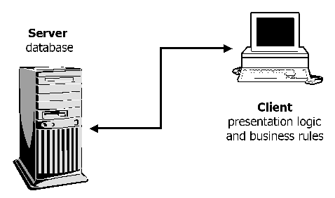
DUAL TIER ARCHITECTURE
The Personal Computer
Necessity of Providing Personal Software
The Client Server Model was Born!!
Logical System Components – Most of which are on the Client

Slide 21
Dual Tier – Advantages & Disadvantages
Advantages
  Less Expensive than Mainframe
Disadvantages
  The Connections to the Database Server are very Expensive
  One can only connects a limited number of users to a server before Database Server spends more time managing connections than processing requests
  Cost-ineffective.
  Many users only use their connections 2-3% of the time.

Slide 22
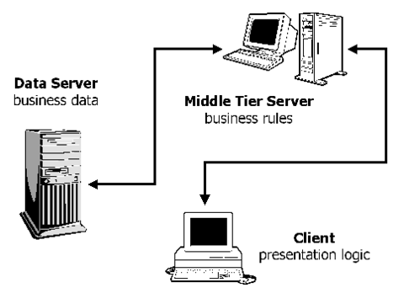
3-TIER ARCHITECTURE
These Applications runs on the Traditional Client/Server Model But from a Application server.
Client only Displays the GUI and data, but has no part in producing results
Database Server Serves to few Connections

Slide 23
3-Tier Advantages
Scalability
  The Application Servers can be deployed on many machines
  The Database no longer requires a connection from every client.
Reusability
  If a standard object is employed, the specific language of implementation of middle tier can be made transparent.
  Data Integrity
  The middle tier can ensure that only valid data is allowed to be updated in the database.

Slide 24
Improved Security
  Since the client doesn’t have direct access to the database, Data layer is more secure.
  Business Logic is generally more secure since it is placed on a secured central server.
Reduced Distribution
  Changes to business logic only need to be updated on application servers and need not to distributed on clients
Improved Availability
  Mission Critical Applications can make use of redundant application servers and redundant application servers, so it can recover from network of server failures.

Slide 25
3-Tier Disadvantages
Increased Complexity / Effort
  In General 3-tier Architecture is more complex to build compared to 2-tier Architecture.
  Point of Communication are doubled.

Slide 26
3-TIER APPLICATION IN JSP WITH JAVA
The Program is organized into three major distinctive tiers or layers:
  Presentation Layer (User Interface)
  Business Layer (Business Access Layer)
  Data Layer (Data Access Layer)

Slide 27
Client Requirement
I am running a Software company and the business involves giving employee details and returns as employee information.
I need an application for managing my business systematically.
The basic requirement of this project,
Employee details.
Employee report – full view

Slide 28
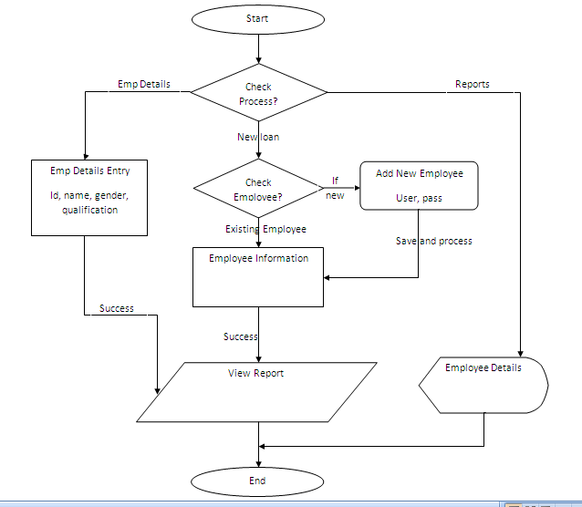

Slide 29
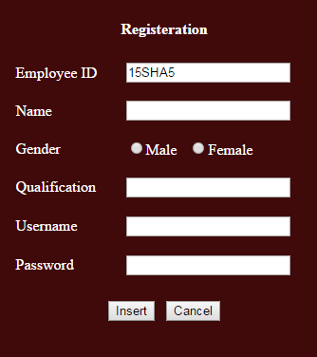
USER INTERFACE LAYER

Slide 30
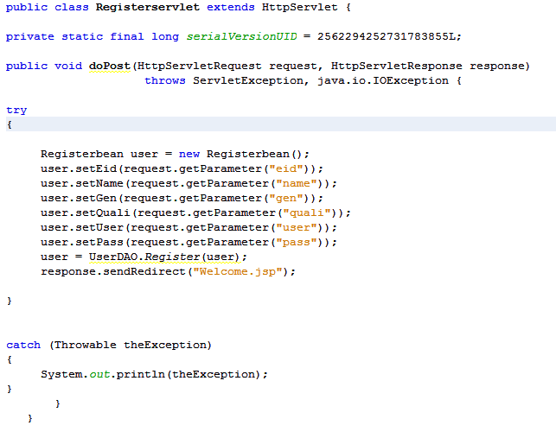
PRESENTATION LAYER

Slide 31
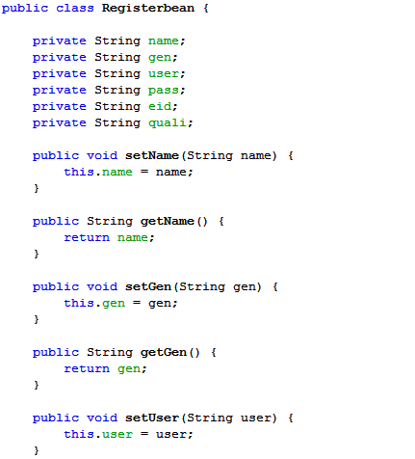
BUSINESS ACCESS LAYER

Slide 32
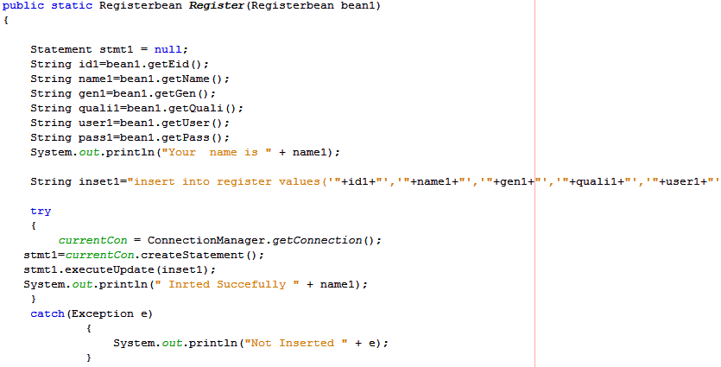
DATA ACCESS LAYER

Slide 33
Thank You.

